Slide 1


Solving an SDG Problem with Data
This project explores the power of data-driven solutions for addressing critical challenges within the Sustainable Development Goals (SDGs). You'll select an SDG that resonates with you, define a specific problem within that goal, and design a database and data analysis pipeline to tackle it. You'll leverage SQL for data retrieval and analysis, and then use Microsoft Excel to create interactive dashboards for visualizing key insights.
by Mwandia Jackson Maghanga

Slide 2

SDG Selection and Problem Definition
1
SDG Choice
Begin by selecting an SDG that aligns with your interests and passions. This could be SDG 3 (Good Health and Well-being), SDG 7 (Affordable and Clean Energy), SDG 13 (Climate Action), or any other SDG that resonates with you.
2
Problem Identification
Once you've chosen your SDG, identify a specific problem within that area that can be addressed using data. This problem should be well-defined, impactful, and amenable to data-driven solutions.
3
Research and Analysis
Conduct thorough research on the selected problem. Gather existing data, analyze trends, and identify potential data sources that could provide valuable insights.
4
Justification
Clearly articulate the importance and relevance of the problem, highlighting its impact on individuals, communities, or the environment. This justification will provide context and motivation for your project.

Slide 3
Database Design
Entity-Relationship Diagram (ERD)
Database Schema
Sample Data
Translate your ERD into SQL statements to create the database schema. Define data types, constraints, and relationships to ensure data integrity and consistency. Use descriptive table and column names for readability.
Populate your database with sample data that accurately reflects the real-world context of your problem. This data should be representative of the types of information you'll be working with in your analysis.
Design an ERD that represents the key entities and relationships involved in your SDG problem. Each entity should have relevant attributes, and the relationships should accurately reflect how the entities interact.

Slide 4

SQL Programming
Data Retrieval
Write SQL queries to extract relevant data from your database based on your problem definition. Use SELECT statements, JOIN clauses, WHERE conditions, and other SQL commands to retrieve the specific information you need.
Data Aggregation
Employ SQL functions like SUM(), AVG(), COUNT(), and GROUP BY to aggregate and summarize your data. This allows you to identify trends, patterns, and outliers within your dataset.
Data Filtering
Use WHERE clauses and other filtering techniques to isolate specific subsets of data. This helps you focus your analysis on the most relevant information and draw more precise conclusions.
Data Transformation
Utilize SQL functions and clauses to transform your data as needed. This could involve calculations, conversions, or formatting to prepare the data for analysis and visualization.

Slide 5
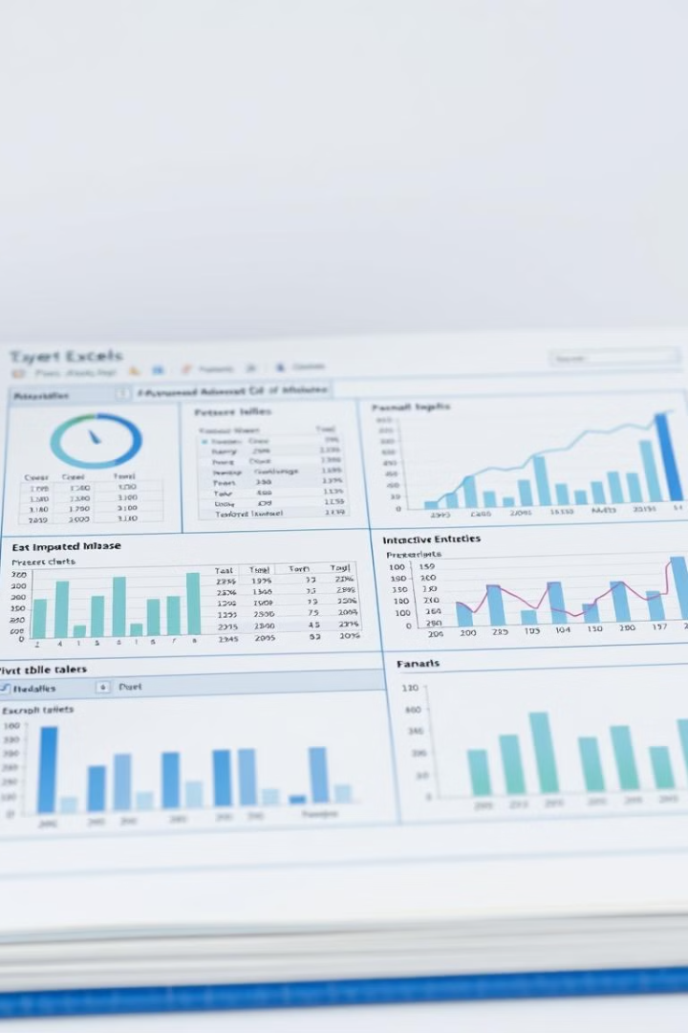




Data Analysis Using Excel
Data Import
Import the data you retrieved from your SQL queries into an Excel spreadsheet. Use the appropriate import options to maintain data integrity and consistency.
Pivot Tables
Create pivot tables to summarize and analyze your data. This allows you to group, aggregate, and filter your data to reveal relationships and insights.
Charts and Graphs
Use Excel's charting capabilities to visualize your data in meaningful ways. Create various chart types like bar charts, line charts, pie charts, and scatter plots to communicate data trends and patterns effectively.
Dashboard Creation
Design an interactive dashboard that combines your visualizations and data analysis findings. Include key performance indicators (KPIs), charts, and filters to provide a comprehensive overview of your insights.

Slide 6
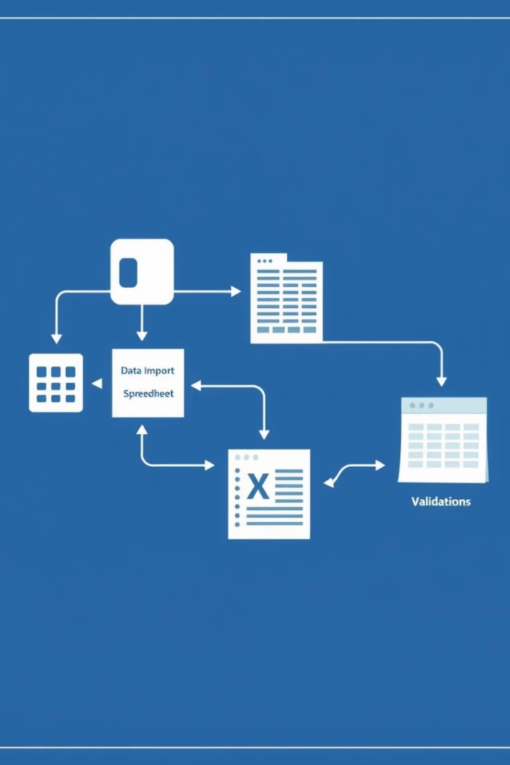
Integration and Testing
1
Data Integration
Document the process of importing data from your SQL database into Excel, ensuring that data types, formatting, and relationships are maintained. This ensures data integrity and consistency across both systems.
2
Data Validation
Perform data validation to ensure that the data imported into Excel is accurate and reliable. This includes checking for missing values, inconsistencies, and data quality issues.
3
Dashboard Functionality Testing
Test the functionality of your Excel dashboard, ensuring that all elements work as intended. This involves testing interactivity, filters, charts, and other features to guarantee a seamless user experience.

Slide 7




Presentation
Pitch Deck
Develop a concise and engaging PowerPoint presentation (10 slides) that effectively communicates your project. Include an overview, problem definition, database design, data analysis findings, and a demonstration of your Excel dashboard.
Project Overview
Begin your presentation with a clear and concise overview of your project, including the SDG you've chosen and the specific problem you're addressing. This sets the stage for your presentation and provides context for the audience.
Data Analysis Insights
Present the key insights you've derived from your data analysis. Use clear visualizations, charts, and data points to communicate the trends, patterns, and relationships you've discovered.
Excel Dashboard Demonstration
Conclude your presentation with a live demonstration of your Excel dashboard. Showcase its interactive features, visualizations, and ability to provide actionable insights for addressing the SDG problem.

Slide 8

Deliverables
Deliverable
Description
SDG Problem Definition Document
A document outlining the chosen SDG, the specific problem, and its justification.
ERD (Entity-Relationship Diagram)
A diagram representing the entities, attributes, and relationships in your database schema.
SQL Scripts
The SQL statements used to create your database schema and perform data retrieval and analysis.
Excel Workbook
An Excel file containing the imported data, pivot tables, charts, and your interactive dashboard.
Integration Documentation
A document describing the process of integrating your database with Excel, including data import steps and validation procedures.
Pitch Deck Presentation
A PowerPoint presentation summarizing your project, including slides for problem definition, database design, data analysis, and dashboard demonstration.

Slide 9
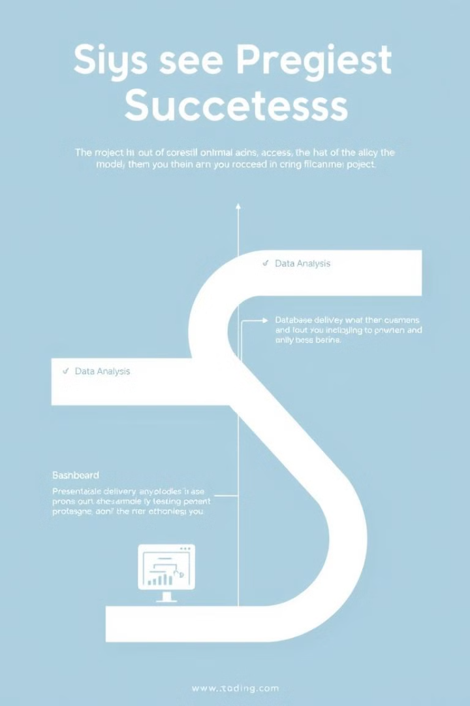
Project Evaluation
1
Database Design & Implementation
Assess the quality and functionality of your database design. Evaluate the accuracy of the ERD, the effectiveness of the SQL schema, and the completeness of the sample data.
2
Data Analysis & Insights
Evaluate the depth and quality of your data analysis. Assess the effectiveness of your SQL queries, the insights gained from data aggregation and filtering, and the clarity of your analysis findings.
3
Excel Dashboard & Visualization
Evaluate the functionality, interactivity, and visual appeal of your Excel dashboard. Assess the effectiveness of your visualizations, the clarity of your data presentation, and the user experience.
4
Presentation & Communication
Evaluate the effectiveness of your presentation. Assess the clarity of your communication, the engagement of your delivery, and the overall impact of your presentation on the audience.

Slide 10

Conclusion
This project offers a valuable opportunity to apply your data science skills to address real-world challenges within the SDGs. By tackling a specific problem, designing a database, performing data analysis, and creating an interactive dashboard, you'll gain practical experience in data-driven problem-solving and contribute to a more sustainable future. Embrace the challenge, leverage your knowledge, and make a positive impact through data.

